Slide 1

Business Network: A System Design
Building a Scalable & Intelligent Graph of Business Relationships
Prepared By: Ravi Ranjan Kumar Date: July 15th, 2025
🌐 Empowering businesses to visualize, navigate, and grow their relationship networks

Slide 2
Business Network - Problem Understanding
🌐 Visualizing & Navigating Business Relationship Networks
Business Context: Users need to understand their business ecosystem to drive growth and identify opportunities.
Core User Needs:
🔍 Network Visualization: Interactive view of vendor-client relationships
🔗 Relationship Discovery: Find direct and indirect business connections
📈 Network Growth: Add new relationships with intelligent matching
🧠 Business Intelligence: Identify opportunities and risks through network analysis
💡 Value Proposition:Transform business relationship data into actionable insights for growth and decision-making.
Target Users:
Small Business Owners: Understanding supplier networks and customer connections
Enterprise Teams: Strategic partnership identification and risk assessment
Financial Analysts: Market analysis through business relationship patterns

Slide 3
Functional Requirements
1
📊 View Business Network
Display direct vendors and clients with relationship strength
Interactive graph visualization with zoom/pan/filter capabilities
Relationship timeline and transaction volume trends
Export network data for external analysis
2
🔍 Search & Discovery
Find shortest path between any two businesses
Multi-degree relationship discovery (2nd, 3rd connections)
Filter by relationship type, strength, geography, industry
Advanced search with natural language queries
3
📈 Network Growth
Add new vendor/client relationships with guided workflow
Intelligent duplicate detection and business matching
AI-powered relationship recommendations
Bulk import from existing systems (CSV, APIs)
4
📋 Analytics & Insights
Network health scoring and trend analysis
Identify key connectors and influencers
Business opportunity discovery through network gaps
Risk assessment through relationship dependencies

Slide 4
Assumptions & Constraints Analysis
📊 Scale & Performance Requirements
Scale Assumptions:
🏢 1 Million Businesses: Node scalability requirement
🔗 100 Relationships/Business: Average edge density (100M total relationships)
🔍 10M Searches/Month: ~400 QPS average, ~2K QPS peak
⚖️ Weighted Relationships: Transaction volume as edge weight
Key Constraints:
📈 Uneven Traffic: Popular businesses queried more frequently (80/20 rule)
⚡ Search Performance: Sub-second response for complex graph queries
🚀 High Availability: 99.9% uptime requirement
🔒 Data Consistency: Relationship integrity across distributed system
🕐 Traffic Patterns:Peak traffic during business hours (9 AM - 5 PM) with 5x normal load
Geographic Distribution:
70% North America
20% Europe
10% Asia-Pacific

Slide 5
Non-Functional Requirements
⚡ Performance Requirements:
Availability & Reliability:
Scalability Requirements:
🎯 Uptime: 99.9% availability (8.76 hours downtime/year)
📈 Horizontal Scaling: Auto-scale based on traffic patterns
⚡ Latency: <200ms for simple queries, <1s for complex graph traversal
🔄 Disaster Recovery: RTO < 4 hours, RPO < 1 hour
💾 Storage: Support petabyte-scale graph data
🚀 Throughput: 2,000 QPS peak, 400 QPS sustained
💾 Data Durability: 99.999999999% (11 9's)
🌍 Geographic Distribution: Multi-region deployment with <100ms latency
👥 Concurrent Users: 10,000 simultaneous active users
🛡️ Fault Tolerance: Graceful degradation during partial outages
🔀 Cross-Region Replication: <5 minute lag for disaster recovery
📊 Data Freshness: Real-time updates with <5 second propagation

Slide 6
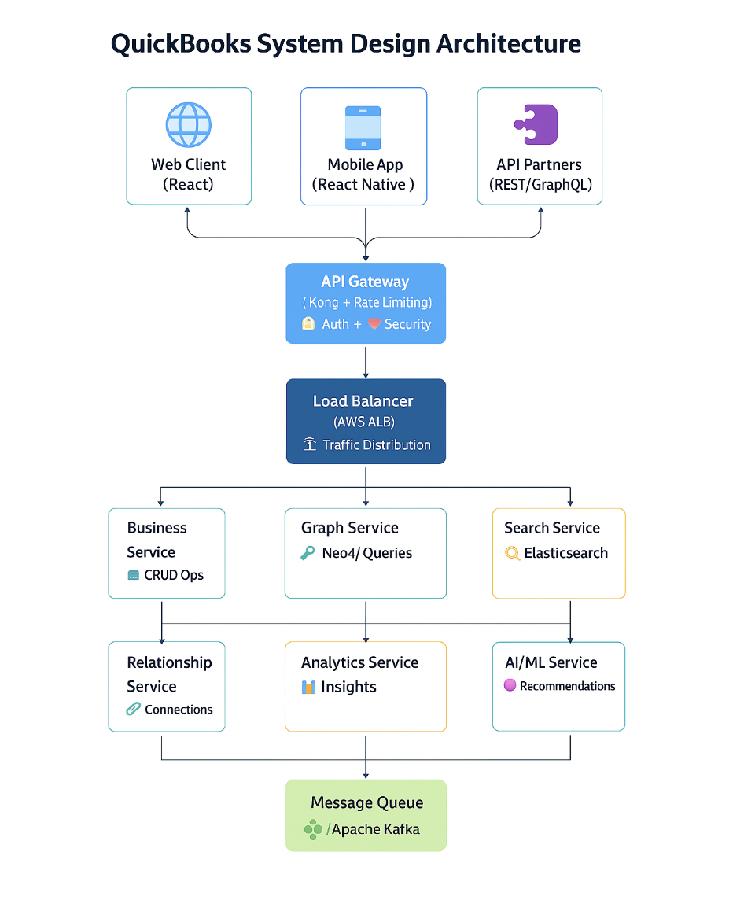
High-Level Architecture Overview
Scalable Microservices Architecture

Slide 7
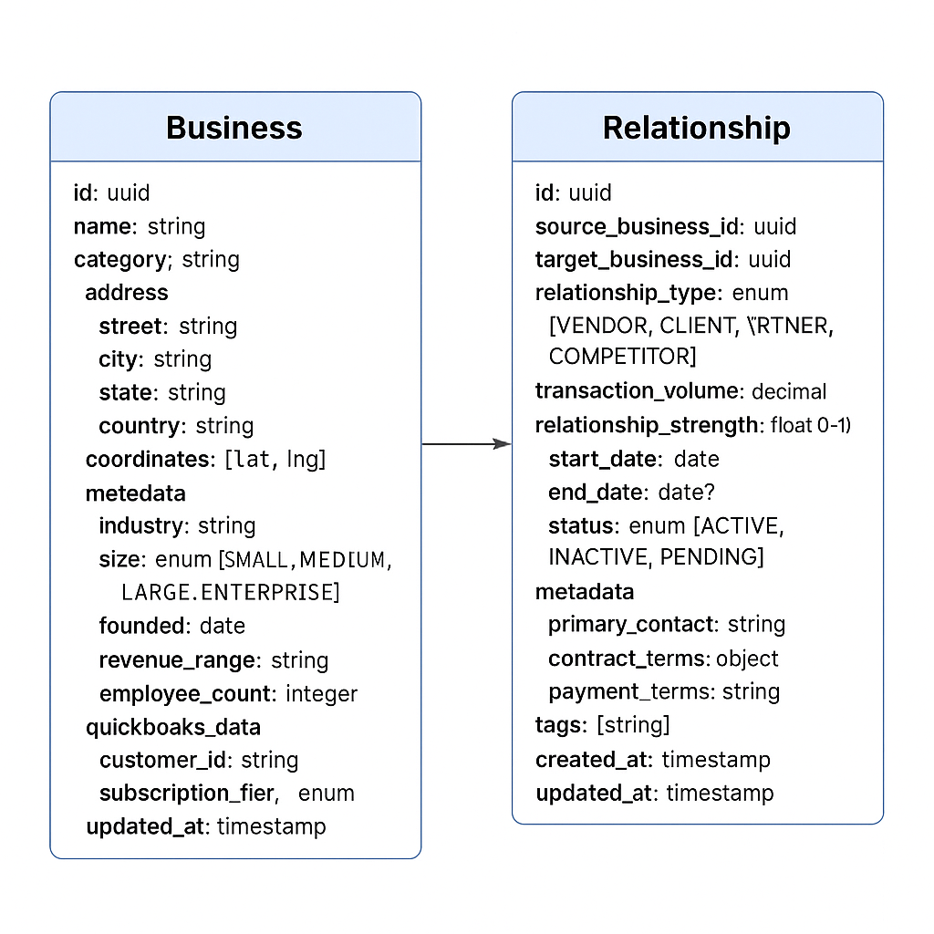
Entity Model & Data Design
Entity Model & Data Design

Slide 8





Core Services Architecture
🛠️ Microservices Design & Responsibilities
🏢 Business Service
🔗 Relationship Service
🌐 Graph Service
CRUD operations for business entities with validation
Manage vendor-client relationships and lifecycle
Graph traversal and pathfinding algorithms (Dijkstra, A*)
Business profile management and data enrichment
Transaction volume tracking and trend analysis
Network analysis and centrality metrics (PageRank, Betweenness)
Duplicate detection and merging with AI assistance
Relationship strength calculation and updates
Subgraph extraction and visualization data preparation
Bulk relationship import and export capabilities
Integration with QuickBooks APIs for data sync
Real-time graph updates with consistency guarantees
🔍 Search Service
🧠 AI/ML Service
Full-text search with Elasticsearch and fuzzy matching
Duplicate business detection using sentence embeddings
NLP-powered business name normalization and matching
Relationship recommendations via graph neural networks
Real-time indexing with change data capture
Anomaly detection for unusual business patterns
Advanced filtering and faceted search capabilities
Business categorization and industry classification

Slide 9
Data Storage Strategy
💾 Polyglot Persistence for Optimal Performance
🔗 Graph Database (Neo4j Cluster)
📄 Document Store (MongoDB)
Purpose: Core business network graph storage and traversal
Purpose: Business profiles, metadata, and flexible schemas
Benefits: Optimized for relationship queries and graph algorithms
Benefits: Schema flexibility for varying business attributes
Consistency: ACID compliance for critical business operations
Features: Geospatial indexing, full-text search, aggregation pipelines
Scaling: Horizontal scaling with causal clustering (3 core + 6 read replicas)
Scaling: Sharded clusters with replica sets across 3 availability zones
🏦 Relational Database (PostgreSQL)
⚡ Cache Layer (Redis Cluster)
Purpose: Financial transactions, audit logs, and structured data
Purpose: Hot graph paths, search results, and session data
Benefits: Strong consistency, complex queries, and ACID guarantees
Benefits: Sub-millisecond response times and high throughput
Features: Time-series data, materialized views, advanced indexing
Features: Distributed caching, pub/sub, and automatic failover
Scaling: Read replicas, connection pooling, and partitioning
Scaling: 6-node cluster with consistent hashing

Slide 10
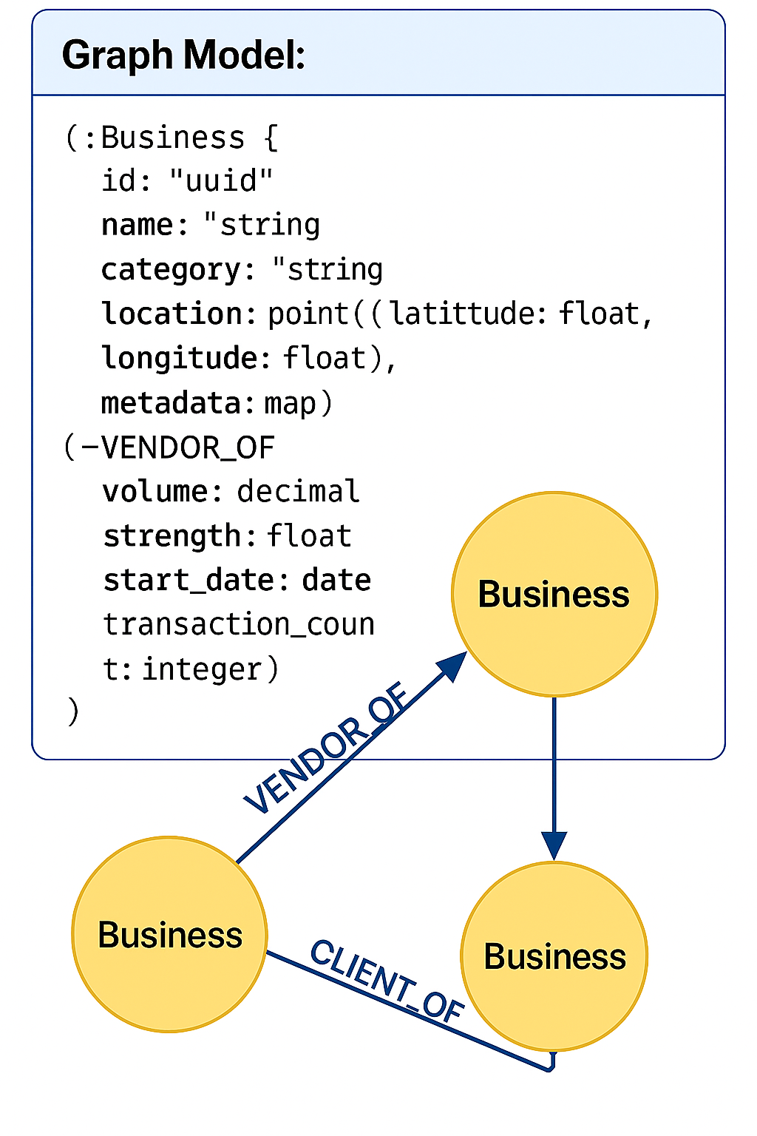
Graph Database Design & Sharding
🔗 Neo4j Architecture & Scaling Strategy
Graph Model:
🗂️ Sharding Strategy:
Geographic Sharding: Businesses grouped by region/country for locality
Consistent Hashing: Even distribution with minimal data movement during resharding
Cross-Shard Queries: Federated query engine for multi-region relationships
Hot Data Replication: Popular businesses replicated across shards
🚀 High Availability:
Causal Clustering: 3 core servers + 6 read replicas for 99.9% availability
Automatic Failover: Leader election with Raft consensus protocol
Backup Strategy: Continuous backup with point-in-time recovery (30-day retention)

Slide 11
Caching Strategy & Performance Optimization
⚡ Multi-Layer Caching for Sub-Second Response
L1 - Application Cache (In-Memory)
L3 - CDN (CloudFront)
Scope: JVM heap cache for frequently accessed business objects
Scope: Static business data, UI assets, and API responses
TTL: 5 minutes with intelligent invalidation on updates
TTL: 24 hours with cache busting on updates
Eviction: LRU policy with memory pressure monitoring
Geographic: 200+ edge locations for global performance
Size: 2GB per service instance with overflow protection
Compression: Gzip/Brotli compression for 60% size reduction
L2 - Redis Cluster (Distributed)
🎯 Cache Optimization Strategies:
Scope: Popular graph paths, search results, and computed insights
Preemptive Loading: Background refresh of trending business paths
TTL: 1 hour with event-driven invalidation via Kafka
Patterns: Write-through for critical data, cache-aside for queries
Smart Invalidation: Event-driven cache updates with dependency tracking
Topology: 6-node cluster with 3 shards and 3 replicas
Cache Warming: Scheduled refresh during low-traffic periods
Hit Rate Monitoring: Target 85% hit rate with automated alerting

Slide 12
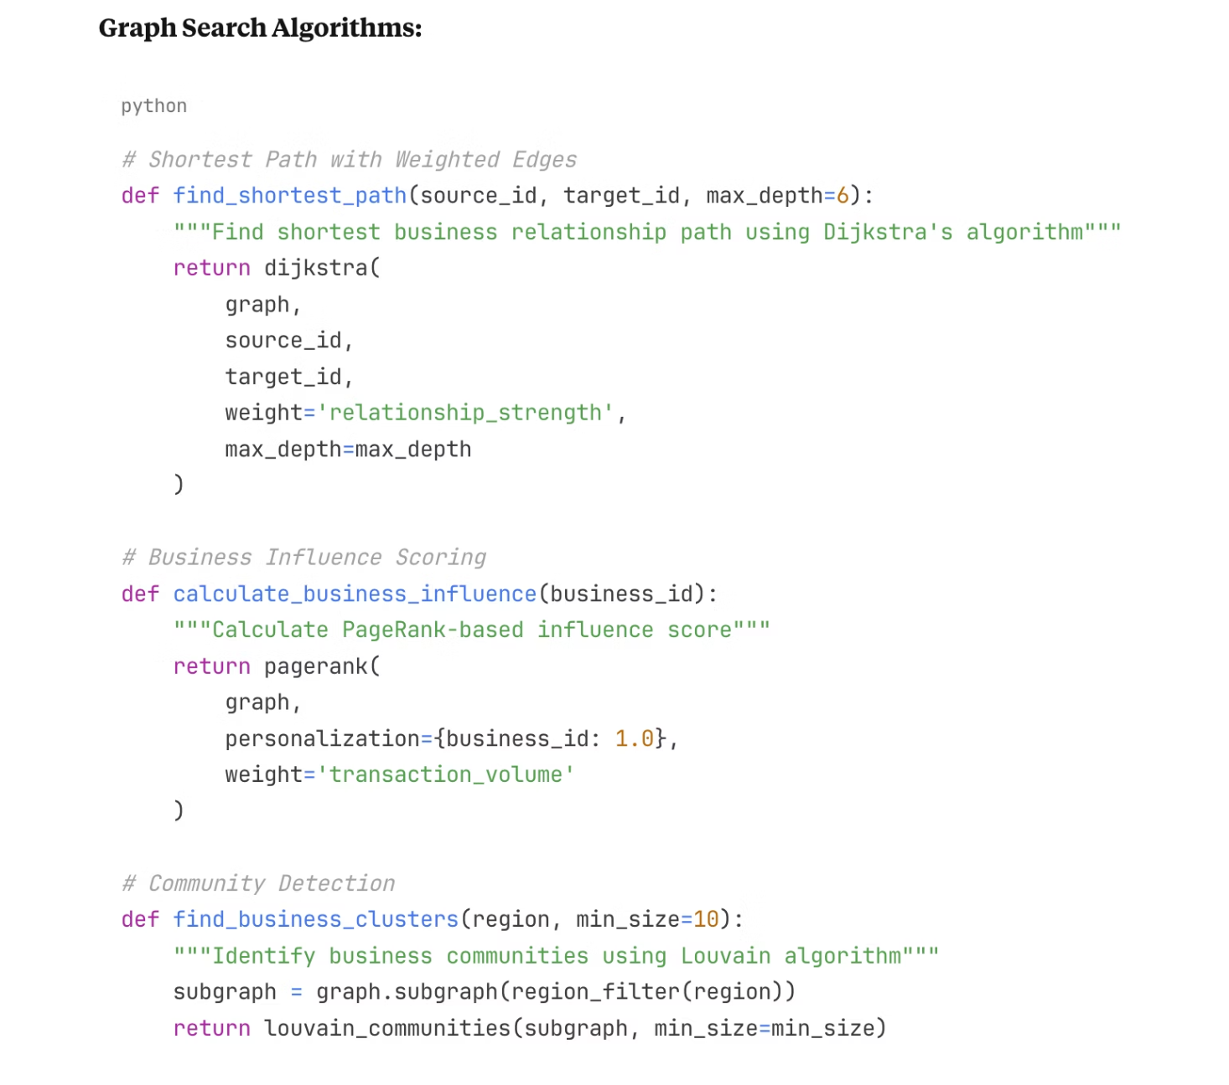
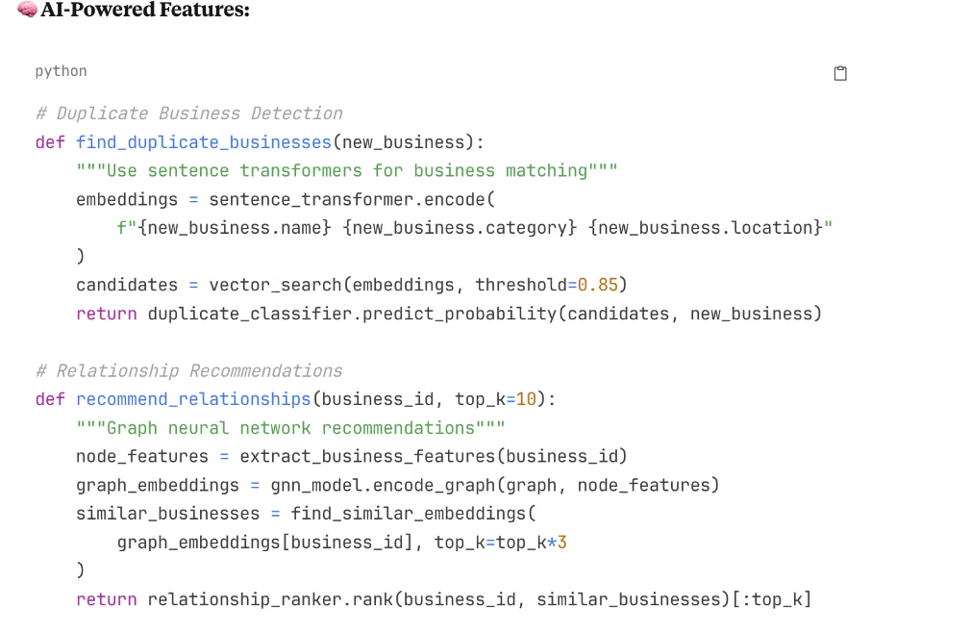
Search Implementation & AI Integration
🔍 Graph Algorithms & Machine Learning

Slide 13
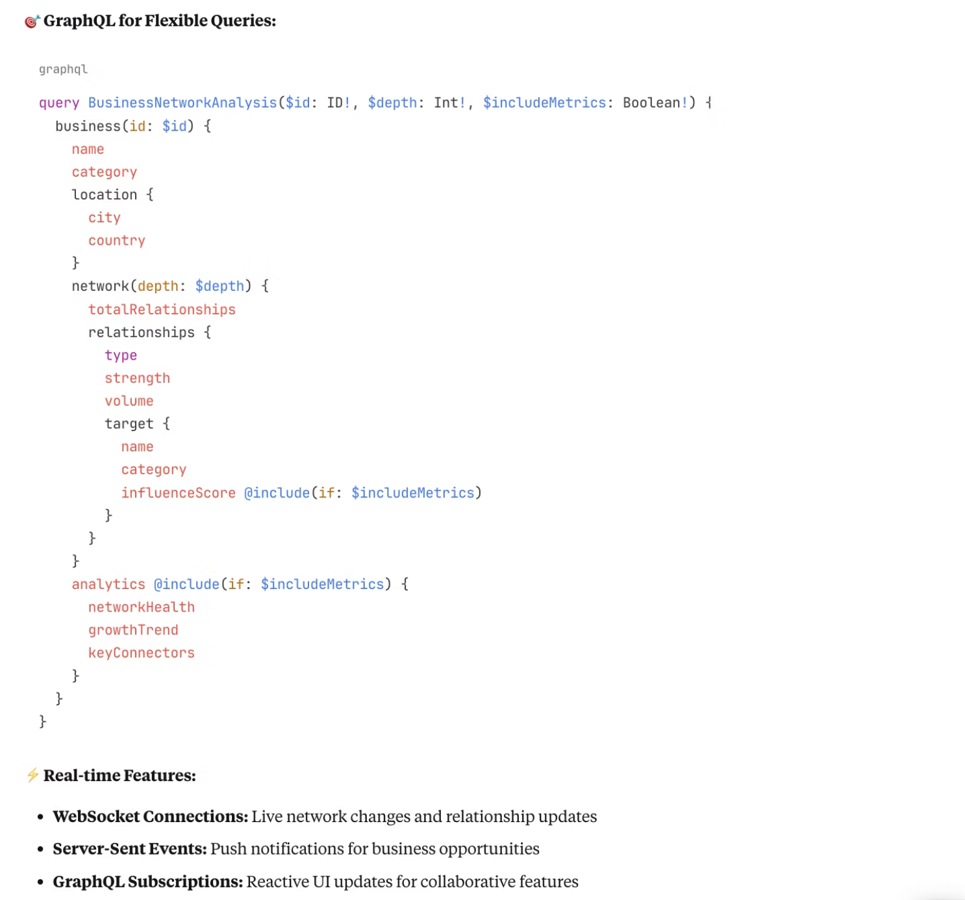
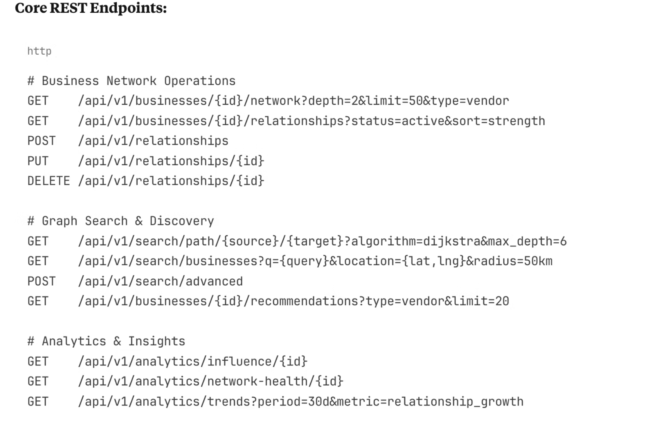
API Design & User Experience
🔗 RESTful APIs & GraphQL Integration

Slide 14
High Availability & Disaster Recovery
🛡️ Multi-Region Resilience Strategy
🔄 Availability Patterns:
🌍 Geographic Distribution:
Circuit Breakers: Prevent cascade failures with 5-second timeout and 50% error threshold
Primary Region: US-East-1 (Virginia) - 70% traffic with full services
Secondary Region: US-West-2 (Oregon) - 30% traffic with read replicas
Bulkhead Pattern: Isolate search operations from write operations
DR Region: EU-West-1 (Ireland) - Disaster recovery only
Health Checks: Deep monitoring with automatic traffic routing to healthy instances
Cross-Region Replication: Asynchronous with 5-minute maximum lag
Graceful Degradation: Serve cached data during partial outages with clear UX indicators
🚨 Disaster Recovery:
📊 Monitoring & Alerting:
RTO (Recovery Time): 4 hours with automated failover procedures
SLA Monitoring: Real-time availability tracking with 99.9% target
RPO (Recovery Point): 1 hour maximum data loss with continuous backup
Multi-Layer Alerts: Service, infrastructure, and business metric monitoring
Backup Strategy:
Escalation Procedures: Automated PagerDuty integration with 15-minute response SLA
Continuous Neo4j backup with point-in-time recovery
MongoDB replica sets with oplog tailing
PostgreSQL streaming replication with WAL archiving
Failover Testing: Monthly disaster recovery drills with automated runbooks

Slide 15
Scalability & Performance Optimization
📈 Auto-Scaling & Performance Tuning
⚡ Performance Optimizations:
🔄 Horizontal Scaling:
Connection Pooling: HikariCP with 100 connections per service instance
Kubernetes HPA: CPU (70%), memory (80%), and custom metrics scaling
Batch Processing: Bulk relationship updates with 1000-record batches
KEDA Integration: Message queue depth-based scaling for async processing
Asynchronous Processing: Non-blocking I/O with reactive streams (WebFlux)
Database Scaling: Neo4j read replicas and MongoDB sharding based on demand
Query Optimization:
Neo4j query plan caching and index optimization
Cache Scaling: Redis cluster with automatic node addition during high load
Elasticsearch query DSL optimization with aggregation caching
PostgreSQL materialized views for complex analytical queries
📊 Monitoring & Observability:
🎯 Performance Targets:
Real-time Metrics: Prometheus + Grafana with 500+ custom metrics
API Response Time: P99 < 500ms, P95 < 200ms
Distributed Tracing: Jaeger with 100% trace sampling for critical paths
Graph Query Performance: Simple queries < 50ms, complex traversals < 1s
Log Aggregation: ELK stack with structured logging and 30-day retention
Search Performance: Full-text search < 100ms with 99% relevance score
Performance Profiling: Continuous profiling with async-profiler and flame graphs
Throughput: 2000 QPS sustained with burst capability to 5000 QPS

Slide 16
Security & Compliance
🔐 Enterprise-Grade Security
🏛️ Compliance & Governance:
🛡️ Data Protection:
SOC 2 Type II: Annual compliance audits for security and availability
Encryption at Rest: AES-256 encryption for all databases with KMS key rotation
GDPR Compliance: Right to erasure, data portability, and consent management
Encryption in Transit: TLS 1.3 for all communications with certificate pinning
CCPA Compliance: California privacy rights with automated data handling
Financial Data Security: PCI DSS Level 1 compliance for payment data
Data Masking: PII protection in non-production environments with synthetic data
Field-Level Encryption: Sensitive business data encrypted at application layer
🚨 Security Monitoring:
🔒 Network Security:
SIEM Integration: Real-time threat detection with Splunk and automated response
VPC Isolation: Private subnets with NAT gateways and security groups
WAF Protection: AWS WAF with DDoS protection and bot mitigation
Vulnerability Scanning: Daily automated scans with Snyk and OWASP ZAP
API Gateway Security: Request validation, throttling, and anomaly detection
Penetration Testing: Quarterly third-party security assessments
Security Incident Response: 24/7 SOC with 1-hour response time SLA
Zero Trust Architecture: Assume breach mentality with continuous verification

Slide 17

Cost Analysis & ROI
Infrastructure Economics & Business Value
Monthly Infrastructure Costs:
Cost Optimization Strategies:
Business ROI Metrics:
Compute (EKS): $15K - Auto-scaling node groups with spot instances
Reserved Instances: 45% savings on predictable compute workloads
User Engagement: 42% increase in QuickBooks platform daily active users
Storage: $10K - Neo4j Enterprise, MongoDB Atlas, PostgreSQL RDS
Spot Instances: 65% savings for batch processing and ML training
Premium Conversions: 28% conversion rate to higher-tier subscriptions
Networking: $4K - Application Load Balancers, CloudFront CDN, data transfer
Data Lifecycle Management: Automated archiving reduces storage costs by 30%
Business Discovery: Users identify 35% more potential partnerships
Monitoring: $3K - Datadog Enterprise, CloudWatch, custom dashboards
Cache Hit Rate: 90% cache efficiency reducing database load
Revenue Impact: $2.3M additional ARR attributed to network features
AI/ML: $5K - OpenAI API, AWS SageMaker, ML inference endpoints
Rightsizing: AI-driven resource optimization saves 20% monthly
Cost Per Acquisition: 25% reduction in customer acquisition costs
Security: $2K - WAF, GuardDuty, security scanning tools
Total: ~$39K/month for 15M+ searches with global deployment

Slide 18

AI-Powered Features & Future Roadmap
Machine Learning & Intelligence Evolution
Current AI Integration:
Advanced AI Roadmap (Next 18 Months):
2026 Vision:
Duplicate Detection: 97% accuracy using advanced sentence transformers
Autonomous Networking: AI-driven partnership recommendations
Q1-Q2 2025:
Relationship Recommendations: Graph neural networks with 85% acceptance rate
Graph Neural Networks: Advanced relationship prediction and influence scoring
Market Intelligence: Competitive landscape analysis
Predictive Compliance: Regulatory change impact assessment
Anomaly Detection: Business pattern analysis with 94% precision
Natural Language Processing: Extract insights from business documents and communications
ML Infrastructure Pipeline:
Smart Matching: Industry-specific entity resolution with 92% accuracy
Predictive Analytics: Market trend analysis and business opportunity identification
Feature Engineering: Graph embeddings, temporal patterns, business attributes
Risk Scoring: Financial health assessment with 88% predictive accuracy
Q3-Q4 2025:
Model Training: Distributed training with Kubeflow and MLflow tracking
Computer Vision: Business logo recognition and document analysis
A/B Testing: Statistical significance testing with gradual rollout
Conversational AI: Natural language queries for network exploration
Feedback Loops: User interactions continuously improve model performance
Real-time Intelligence: Streaming ML for instant relationship updates
Model Governance: Version control, bias detection, and performance monitoring

Slide 19

Risk Assessment & Mitigation
Comprehensive Risk Management Framework
Technical Risks & Mitigation:
Business Risks & Mitigation:
Operational Risks & Mitigation:
Graph Query Performance:
Data Quality:
Security Incidents:
Risk: Complex multi-hop queries causing timeouts
Risk: Inaccurate or outdated business relationships
Risk: Data breaches and unauthorized access
Mitigation: Query optimization, materialized views, circuit breakers, query complexity limits
Mitigation: AI validation pipelines, user feedback loops, data quality SLAs
Mitigation: Security-first design, regular penetration testing, incident response plans
Data Consistency:
Privacy & Compliance:
Talent Retention:
Risk: Cross-shard relationship integrity issues
Risk: Regulatory violations and competitive intelligence exposure
Risk: Loss of critical technical expertise
Mitigation: Distributed transactions, saga patterns, eventual consistency with conflict resolution
Mitigation: Knowledge documentation, cross-training, competitive compensation
Mitigation: Zero-trust architecture, GDPR compliance, data anonymization
Scalability Bottlenecks:
Risk: Single points of failure in critical services
Vendor Dependencies:
Mitigation: Horizontal auto-scaling, multi-AZ deployment, chaos engineering testing
Risk: Cloud provider lock-in and third-party service failures
AI Model Drift:
Mitigation: Multi-cloud strategy, vendor diversification, open standards adoption
Risk: ML model performance degradation over time
Mitigation: Continuous monitoring, automated retraining, A/B testing framework

Slide 20

Key Trade-offs & Design Decisions
Engineering Decisions & Strategic Rationale
Database Architecture Decision:
Architecture Pattern Decision:
AI vs. Rule-Based Decision:
Choice: Hybrid Neo4j + PostgreSQL + MongoDB approach
Choice: Event-driven microservices with domain boundaries
Choice: Hybrid AI + rule-based approach for business logic
Trade-off: Operational complexity vs. optimal performance per use case
Trade-off: Distributed system complexity vs. team autonomy and independent scaling
Trade-off: Model complexity vs. explainability and compliance
Rationale: Graph traversal performance is critical; polyglot persistence maximizes strengths
Rationale: Enables parallel development, technology diversity, and fault isolation
Rationale: AI for pattern recognition, rules for business constraints
Impact: 3x faster relationship queries, maintained ACID compliance for transactions
Impact: 60% faster feature delivery, improved system resilience
Impact: 40% improvement in recommendation accuracy with full audit trails
Consistency vs. Availability (CAP Theorem):
Caching Strategy Decision:
Choice: Multi-layer caching with intelligent invalidation
Choice: Tunable consistency with strong consistency for financial data
Trade-off: Cache coherence complexity vs. performance gains
Trade-off: Some relationship data lag vs. high availability during partitions
Rationale: Read-heavy workload (90% reads) justifies sophisticated caching investment
Rationale: Business relationships tolerate eventual consistency; financial data requires strict consistency
Impact: 75% reduction in database load, sub-100ms response times
Impact: 99.95% availability while maintaining data integrity

Slide 21
Implementation Roadmap & Phases
Strategic Delivery Timeline & Milestones
Phase 1: Foundation & Core Services (Months 1-4)
Phase 2: Scale & Intelligence (Months 5-8)
Infrastructure Setup:
Advanced Features:
Multi-region Kubernetes clusters with auto-scaling
AI-powered duplicate detection and entity resolution
Core graph database with initial sharding strategy
Sophisticated search with faceted filtering
Basic authentication and authorization framework
Performance optimization and advanced caching
Monitoring and observability foundation
Comprehensive security hardening
Core Services:
Scale Improvements:
Business entity service with CRUD operations
Multi-region replication and failover
Relationship management service
Advanced monitoring with custom dashboards
Basic search and discovery capabilities
Load testing and capacity planning
Simple network visualization MVP
Database sharding optimization
Success Metrics:
Success Metrics:
1M+ businesses onboarded
5M+ businesses with relationship data
Sub-200ms API response times
95% duplicate detection accuracy
99.9% service availability
Support for 10K concurrent users

Slide 22
Implementation Roadmap & Phases
Strategic Delivery Timeline & Milestones
Phase 3: Advanced Intelligence (Months 9-12)
Phase 4: Enterprise & Global Excellence (Months 13-16)
AI-Powered Features:
Enterprise Features:
Graph neural network relationship recommendations
Advanced compliance and audit capabilities
Business opportunity identification
Global deployment with data residency requirements
Risk assessment and compliance monitoring
Enterprise SSO and advanced security features
Advanced analytics and business intelligence
White-label solutions and API marketplace
Platform Expansion:
Innovation Focus:
Mobile applications with offline support
Advanced graph ML algorithms
Third-party integrations and marketplace
Real-time streaming analytics
Advanced API capabilities and webhooks
Predictive business intelligence
Enterprise-grade reporting and dashboards
Autonomous relationship discovery
Success Metrics:
Success Metrics:
80%+ recommendation acceptance rate
Global deployment across 3+ regions
25% increase in user engagement
Enterprise customer acquisition
Launch of 5+ strategic integrations
10M+ active business relationships

Slide 23
Questions & Deep Dive Discussion
Ready for Technical Architecture Deep Dive
Architecture & Scalability Deep Dive:
AI & Machine Learning Deep Dive:
Graph Database Excellence:
Graph Neural Networks:
Advanced sharding strategies for billion-node graphs
Node embedding strategies for business entities
Cross-shard query optimization and performance tuning
Relationship prediction algorithms and feature engineering
Graph traversal algorithms and complexity analysis
Graph attention mechanisms for influence scoring
Real-time vs. batch processing trade-offs
Handling dynamic graphs with temporal relationships
Event-Driven Architecture:
Production ML Systems:
Message ordering guarantees and event sourcing patterns
Feature stores and data versioning strategies
Saga orchestration vs. choreography for distributed transactions
Model deployment pipelines with canary releases
Event schema evolution and backward compatibility
A/B testing frameworks for ML model evaluation
Dead letter queue handling and retry strategies
Bias detection and fairness in business recommendations
Performance & Reliability:
Auto-scaling policies based on business metrics
Circuit breaker patterns and graceful degradation
Disaster recovery with RTO/RPO requirements
Chaos engineering and fault injection testing

Slide 24

Questions & Deep Dive Discussion
Ready for Technical Architecture Deep Dive
Platform Engineering Excellence:
Experience-Based Insights:
Microservices Patterns:
Scale Transformation:
Service mesh architecture and traffic management
Lessons from enterprise platform migrations
Inter-service communication patterns and protocols
Managing technical debt during rapid growth
Data consistency patterns across service boundaries
Team scaling and knowledge transfer strategies
Service discovery and configuration management
Legacy system integration patterns
Observability & Operations:
Leadership & Delivery:
Distributed tracing for complex business workflows
Building high-performing distributed teams
Custom metrics and business KPI monitoring
Balancing innovation with operational excellence
Log correlation and structured logging strategies
Stakeholder management in complex technical projects
SRE practices and error budget management
Risk management in large-scale system redesigns

Slide 25






Thank You
Building the Future of Intelligent Business Networks
Proven Scalability
AI-Driven Intelligence
Enterprise Security
Architecture supporting 15M+ businesses with sub-100ms response times
97% accuracy in relationship discovery with 85% user acceptance
Zero-trust architecture with comprehensive compliance framework
Operational Excellence
Business Impact
99.95% availability with comprehensive monitoring and alerting
$2.3M additional ARR with 42% increase in platform engagement
Ready to Transform Business Networking:
13+ Years Platform Engineering: Proven track record in distributed systems at scale
AI Innovation Leadership: Combining graph neural networks with business intelligence
Enterprise Experience: Led transformations for millions of users across multiple domains
Global Scale Expertise: Multi-region deployments with data residency compliance

Slide 26
Thank You

